Slide 1


Slide 2

Project Title: FurnishARt
Hafiz Talha Nazir (CIIT/SP21-BCS-007/ATD)
Muhammad Umer (CIIT/SP21-BCS-016/ATD)
Muhammad Noman (CIIT/SP21-BCS-014/ATD)
Supervisor: Ma’am Bushra Mushtaq
Department of Computer Science
COMSATS University Islamabad, Abbottabad Campus

Slide 3
Agenda of the Presentation
Brief Introduction
Scope
Functional Requirements
Non-Functional Requirements
User Goals
Use Case Diagram
Class Diagram
ER Diagram
Sequence Diagram
Gant Chart
Details of 1st Iteration (30%)
Details of 2nd Iteration (60%)
Conclusion

Slide 4
Brief Introduction
Welcome to FurnishARt, an innovative AR-based Furniture Store Web Application designed to transform your online shopping experience.
The application goal is to enhance the online shopping experience by allowing customers to visualize products in their real-world environment before making a purchase.
The Proposed FurnishARt will include:
AR technology for furniture retail.
Interactive 3D models on our website.
Augmenting virtual products with real-world environments.
Immersive shopping experiences with AR.

Slide 5
Scope
FurnishARt will :
Be a single-seller furniture store.
Integrate AR for viewing 3D furniture models on our AR app.
Enable placing furniture in your space using your smartphone camera.
Allow users to interact with 3D models for a better shopping experience.
Sole focus on furniture products.

Slide 6
Functional Requirements
Customer Functional Requirements:
View Furniture
View AR Preview of Furniture
View 3D Model
Search by Filters
View Listing Details
View Similar Furniture
Add to Cart
Update Cart
Delete from Cart
View Cart
Proceed to Checkout
Enter Payment Information

Slide 7
Select Shipping Method
Place Order
View Orders
View Order Status
View Order History
Write Review
View Customer Reviews
Augment Multiple Furniture Items from List
Login
Forget Details
Logout

Slide 8
Admin Functional Requirements:
Add Furniture Listings
Update Furniture Listings
Delete Furniture Listings
View Furniture Listings on Admin Panel
Add 3D Models
Update 3D Models
Delete 3D Models
Generate Inventory Reports
Update Order Status
View Sales & Stock Dashboard
Manage Stocks

Slide 9
Non-Functional Requirements
Usability
User-Friendly Interface
Clear Instructions
Intuitiveness
Accessibility
Error Handling
Performance
Fast Loading and Execution
Scalability
Large Data Handling
Concurrent Users
Transaction Processing

Slide 10
User Goals
Visualize Furniture in AR: Easily view and interact with 3D furniture models in their space using augmented reality.
Make Informed Purchases: Assess furniture size, style, and suitability before making a purchase decision.
Easy Navigation: Navigate intuitively through the platform to browse, add to cart, and checkout seamlessly.
Read and Write Reviews: Access and contribute customer reviews to make informed choices and share experiences.
Manage Orders: Track order status, view history, and manage shopping cart efficiently.
Accessibility: Access the platform easily across devices with adherence to accessibility standards.
Secure Transactions: Ensure secure payment processing and safeguard personal information.
Explore Similar Products: Discover related furniture items based on preferences for enhanced shopping options.

Slide 11
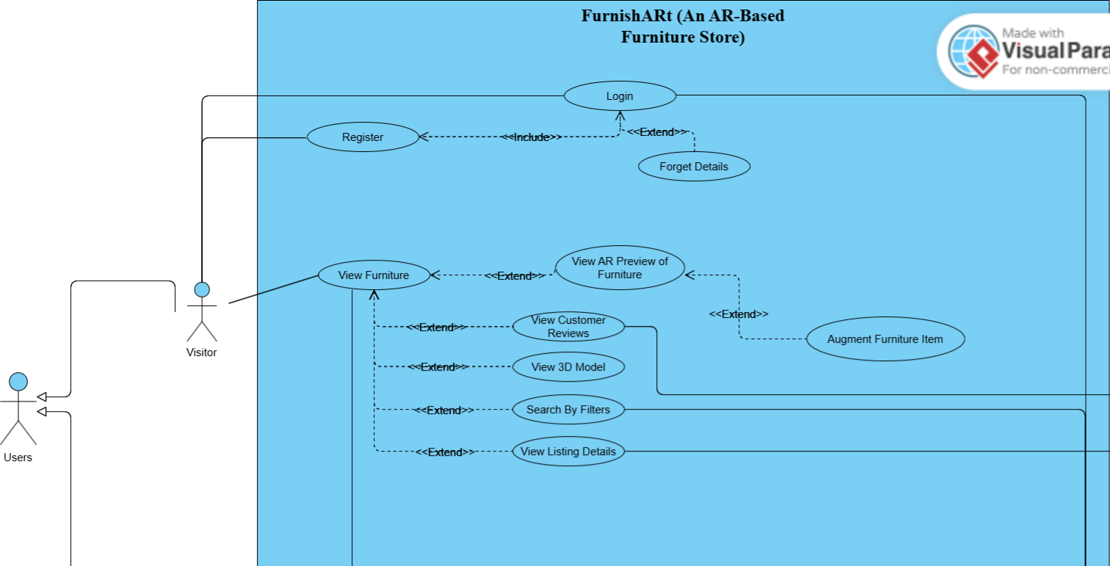
Use Case Diagram (Part 1)

Slide 12
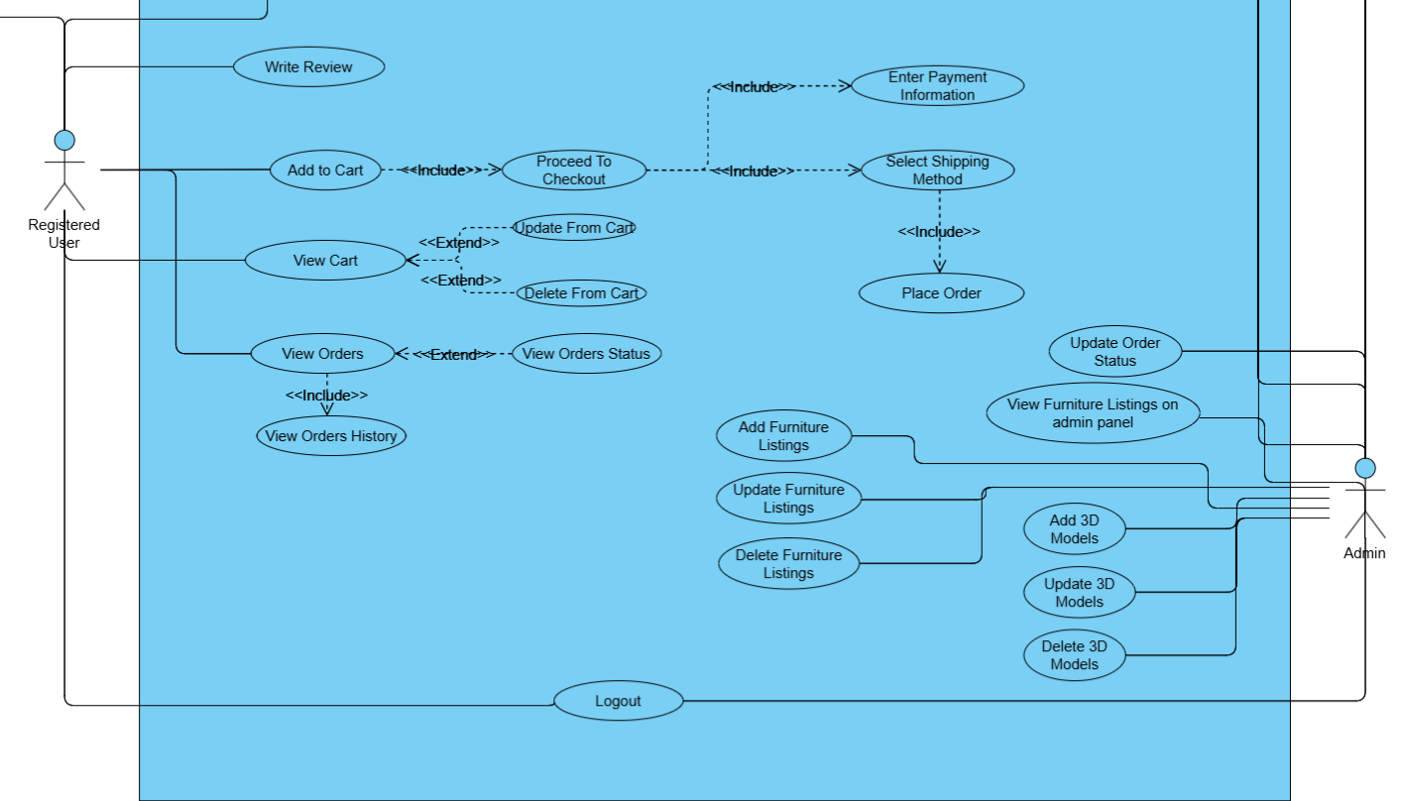
Use Case Diagram (Part 2)

Slide 13
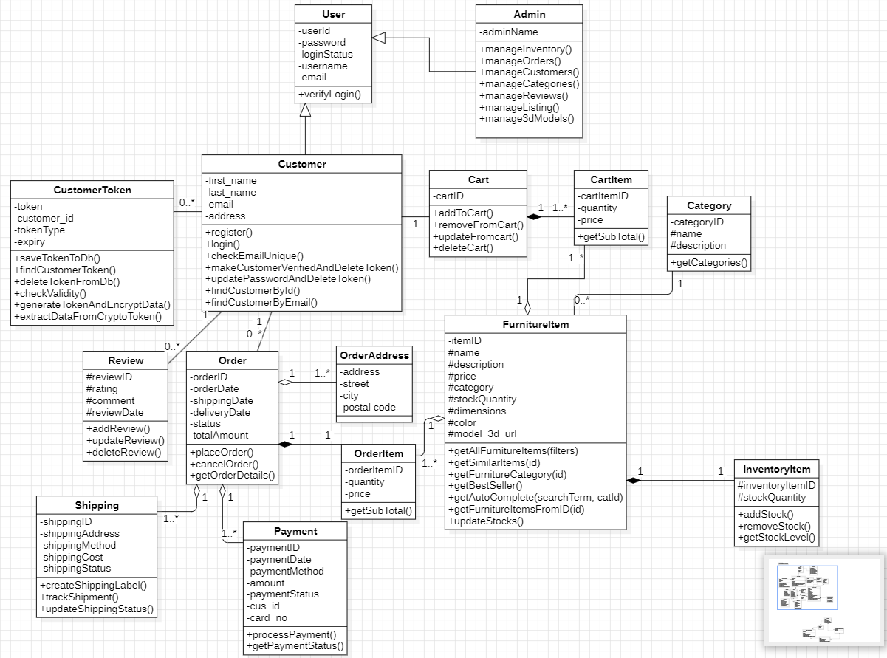
Website Class Diagram

Slide 14
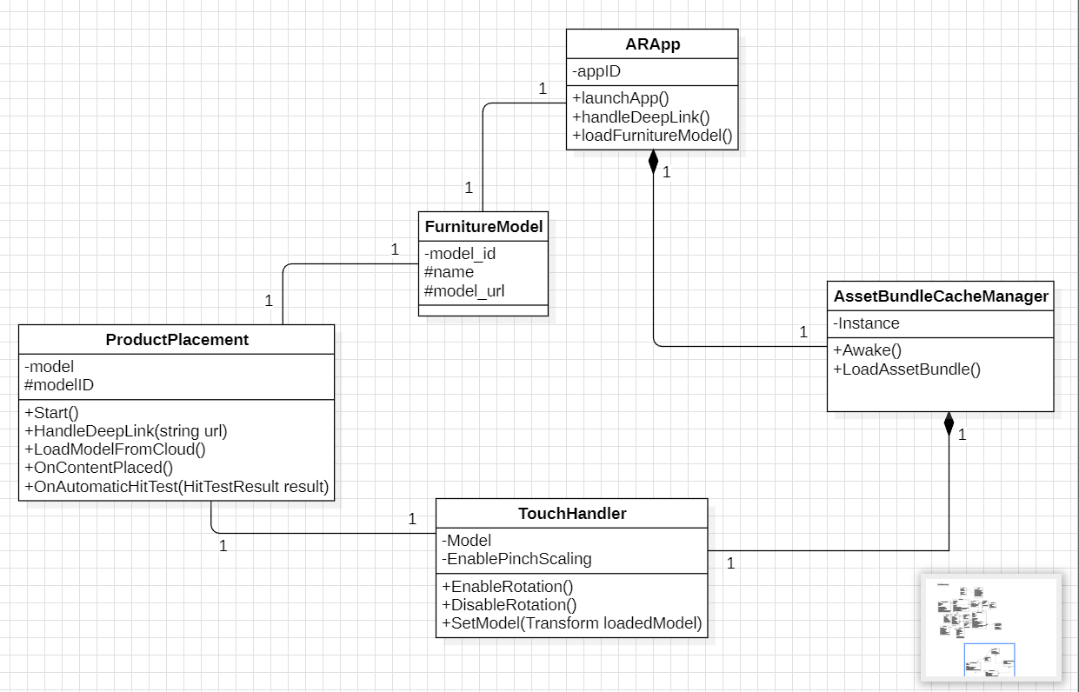
AR Class Diagram

Slide 15
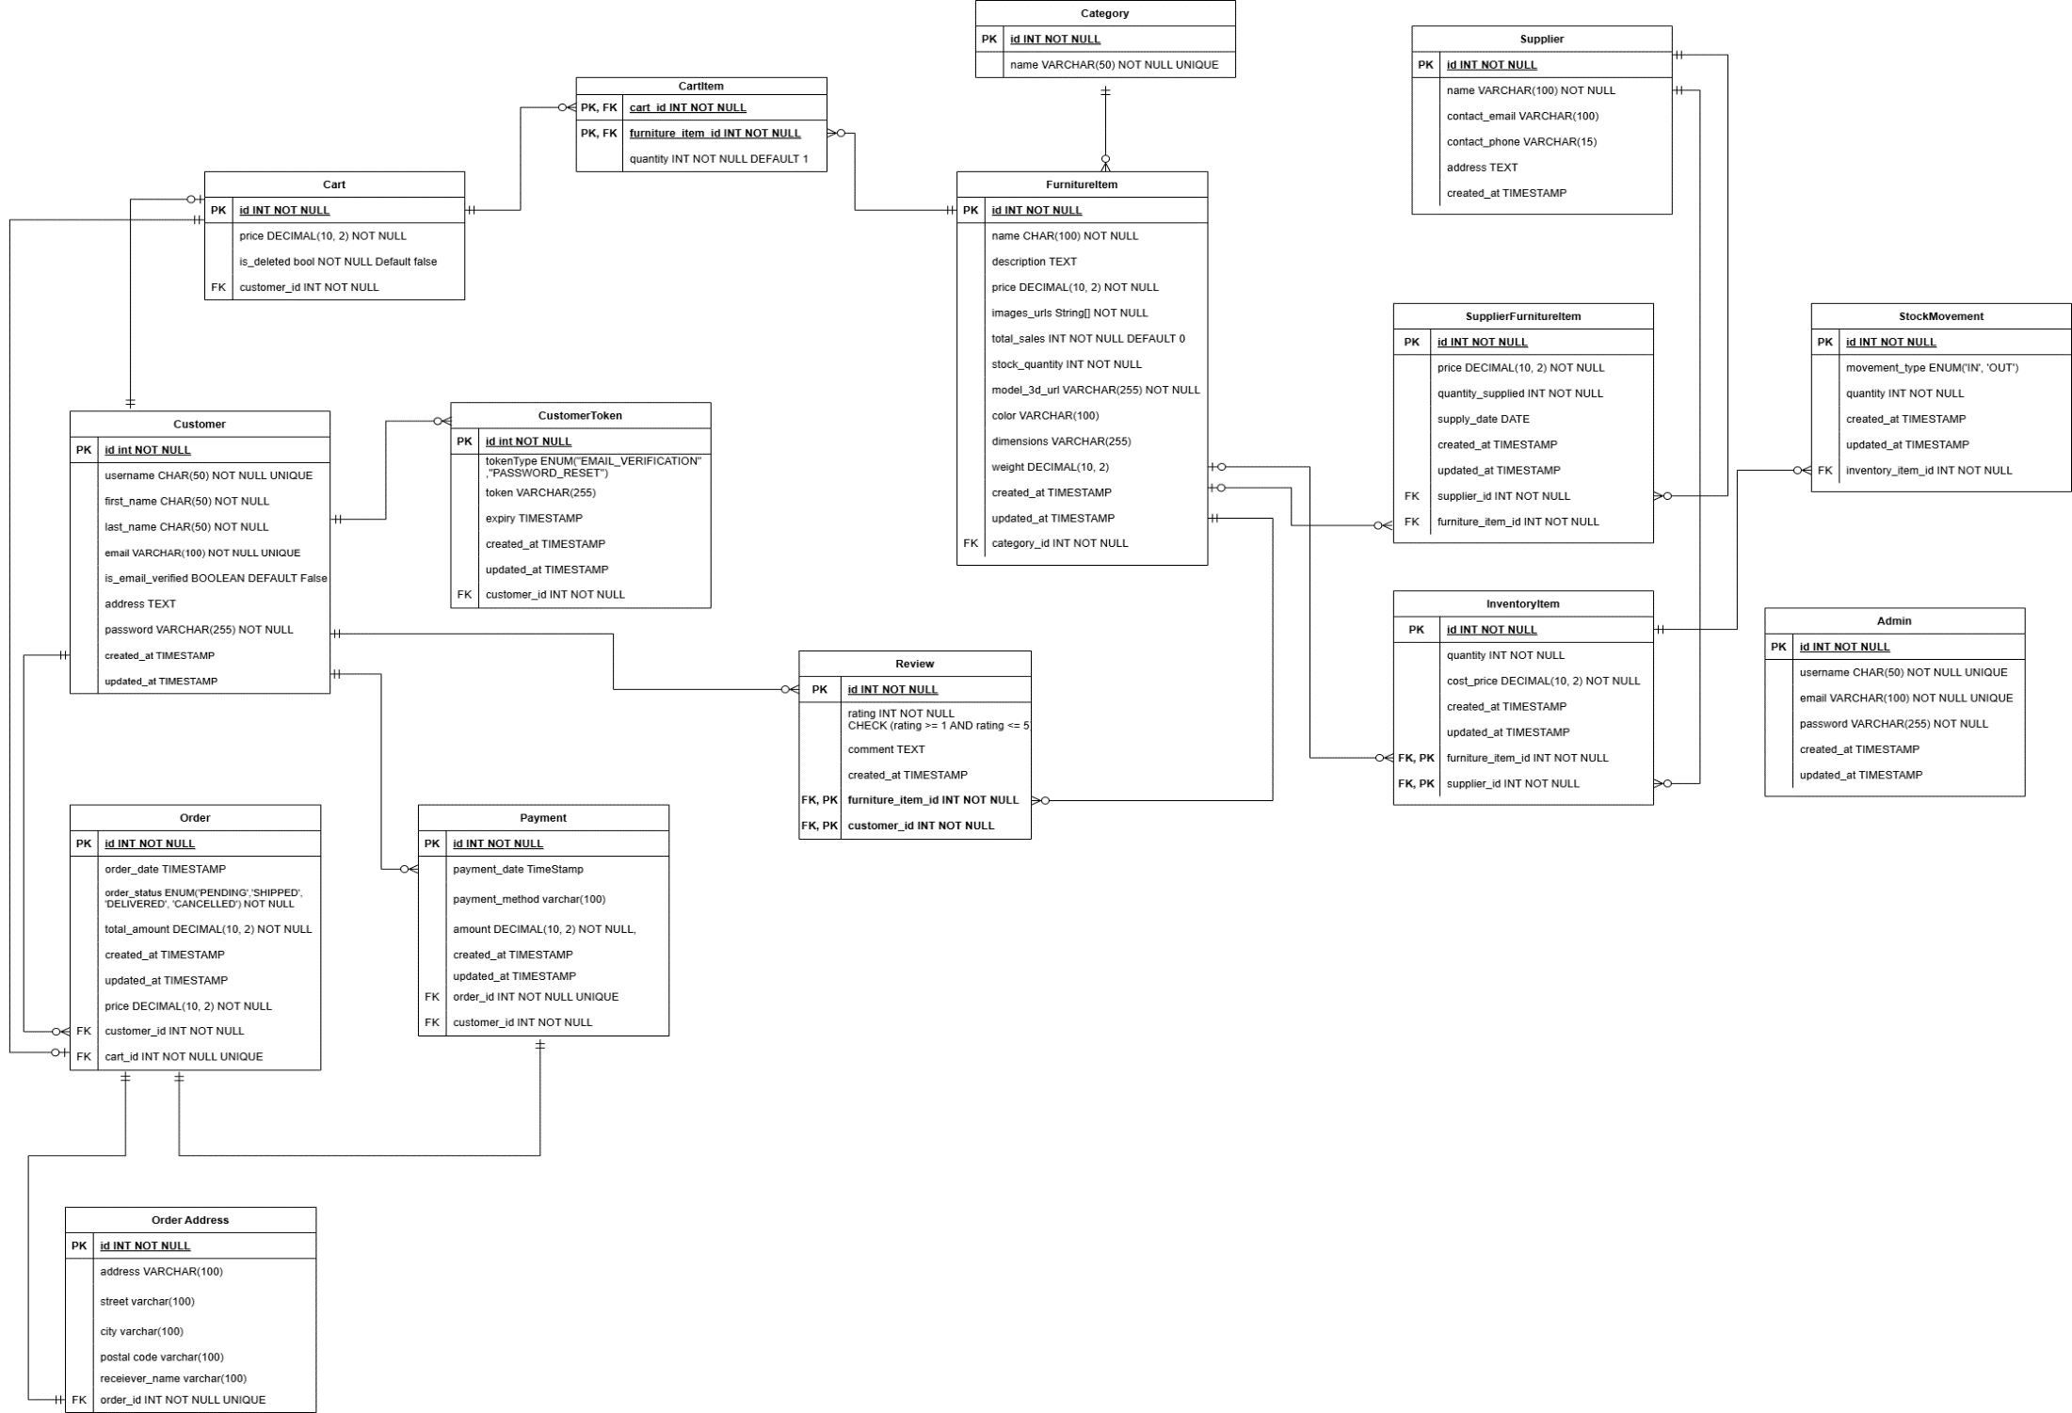
ER Diagram

Slide 16
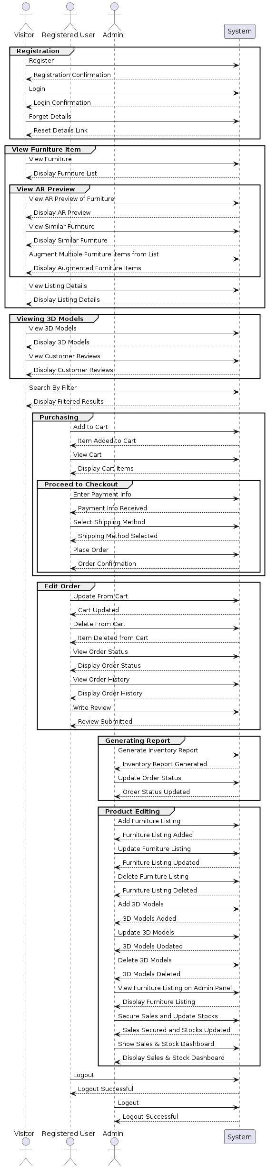
Sequence Diagram

Slide 17
Details of 2nd Iteration (60%)
Enhanced Cart and Checkout System.
View 3D model on website.
Implement backend functionality for dynamic loading of 3D models.
Enable real-time augmentation of furniture models using scripting.
Design 3D models of other categories Furniture Items.

Slide 18
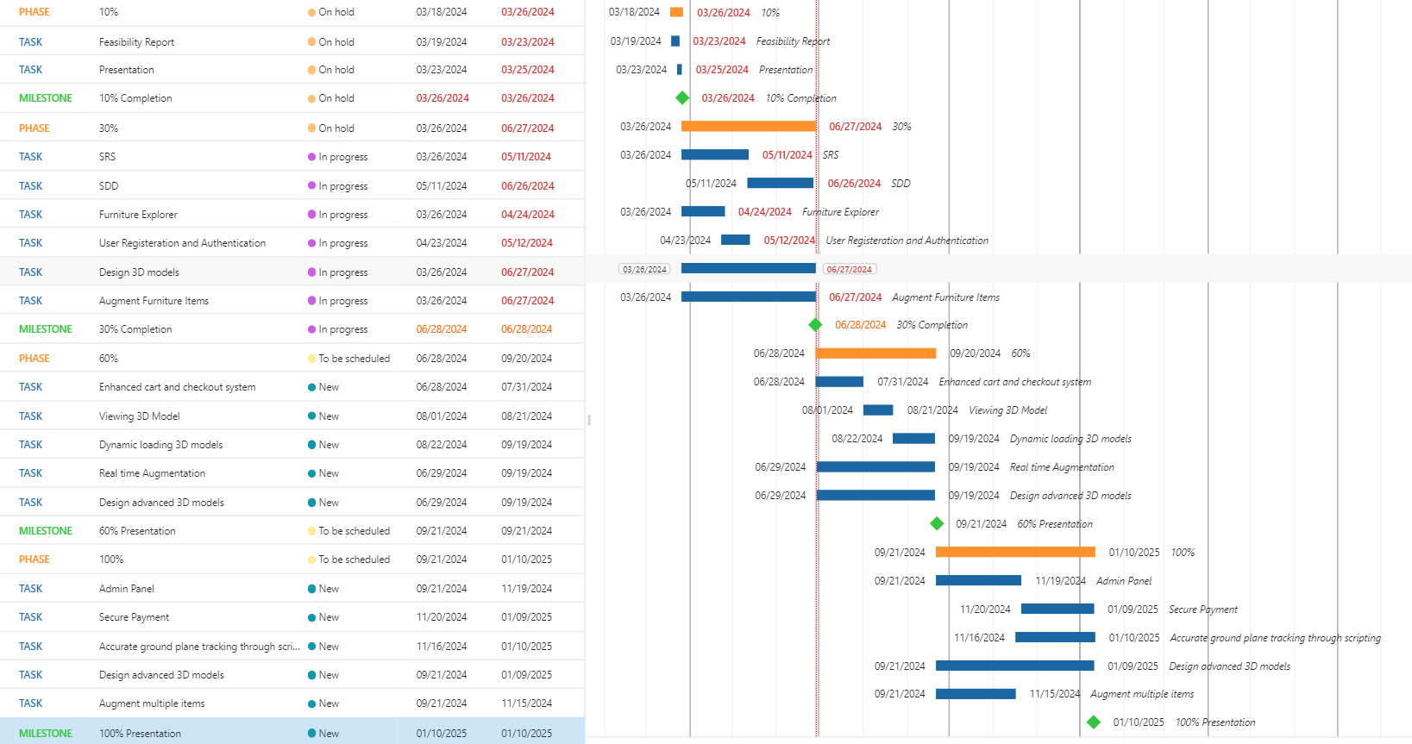
Schedule
Gant Chart

Slide 19
Conclusion
In conclusion, the proposed AR-based furniture store project utilizes augmented reality technology to enhance online furniture shopping. Users can visualize furniture in their living spaces before purchasing, improving decision-making. Through comprehensive exploration of AR, 3D modeling, and e-commerce integration, the project aims to deliver a user-centric platform. With seamless integration and immersive experiences, it has the potential to redefine online furniture shopping.

